Slide 1
Both Way Authentication Protocol

Slide 2
Introduction to HLPSL language
1)A variety of languages and tools based on different formal methods and automated reasoning techniques have been devised and applied to the domain of security protocols.
2)But this High-Level Protocol Specification Language(HLPSL) has a formal semantics that makes it easily translatable into a declarative lower-level term rewriting based language well-suited to automated analysis tools.
3)HLPSL has been devised as a part of the AVISPA project which aims to develop technology for the analysis of large-scale internet security-sensitive protocols and applications.

Slide 3
Introduction to the 2 way authentication process :
1) Multi-factor authentication (2FA) is an electronic authentication method in which a user is granted access to a website or application only after successfully presenting two or more factors to an authentication mechanism.
2)A third party authenticator app enables 2-way authentication, usually by showing a randomly generated and frequently changing code to use for authentication.
3)This authentication adds an additional layer of security to the process by making it harder for attackers to gain access.

Slide 4
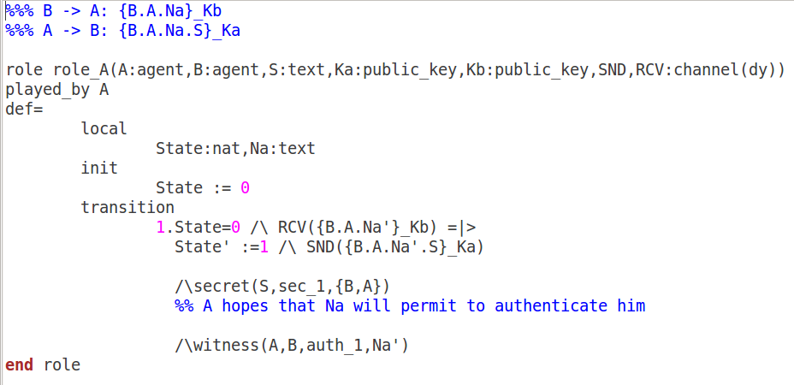
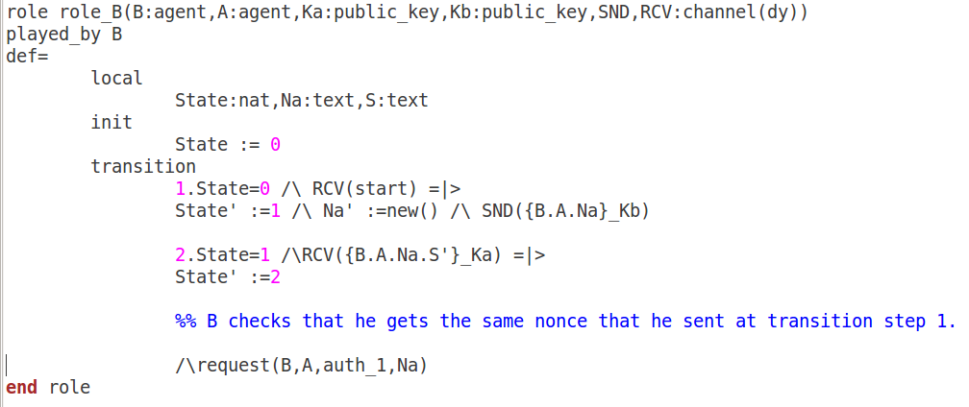
HLPSL code of 2 way authentication :
Role B

Slide 5
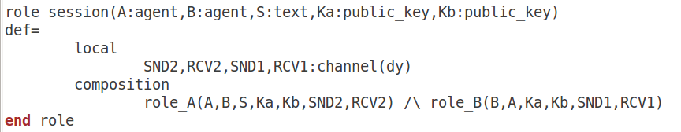
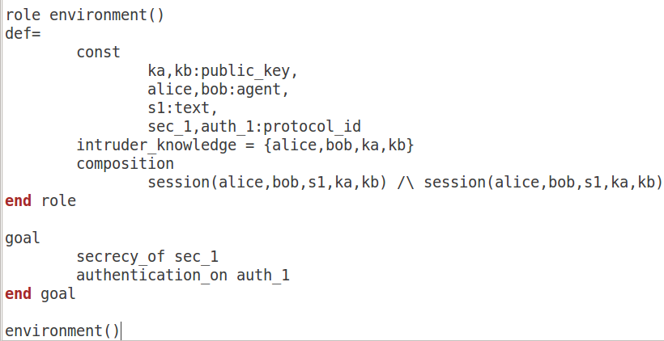
Code:

Slide 6
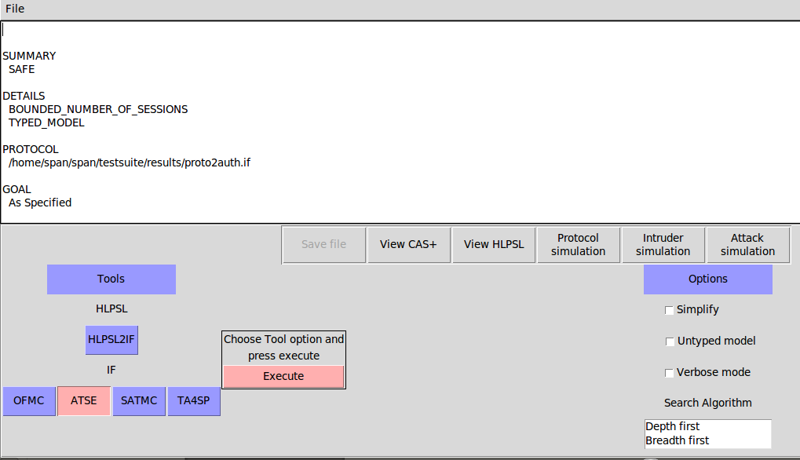
Result:

Slide 7
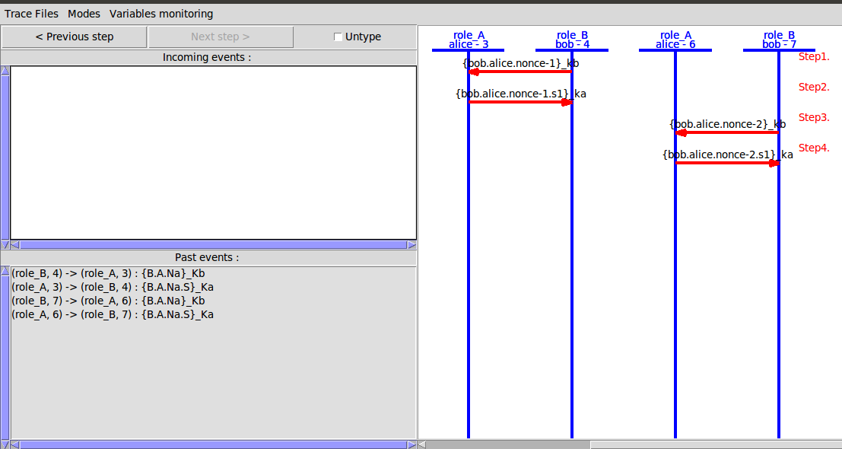
Result:

Slide 8
Future Work:
It will be testing the security of both way authentication mechanism using the AVISPA tool.
1)Testing security of ECDSA using Weierstrass curve.
2) Testing security of ECDSA using Hessian curve.
ECDSA : Elliptic Curve Digital Signature Algorithm
S.Shravya

